Slide 1
Autonomous Car
Nick Bosschaert

Slide 2
Features
Line-tracking
Voltage indicator
Status leds
Obstacle detection (HC-SR04)
Collision detection (Limit switch)
Startup-Tune
Web interface

Slide 3
LEDs
Voltage Indicator
Status leds
RGB led
Green: Battery full > 8V
Blue: Battery mid > 5V
Red: Battery dead < 5V
Green: No problem
Orange: Obstacle or Collision
Red: Lost the line
Blue: On/Off

Slide 4
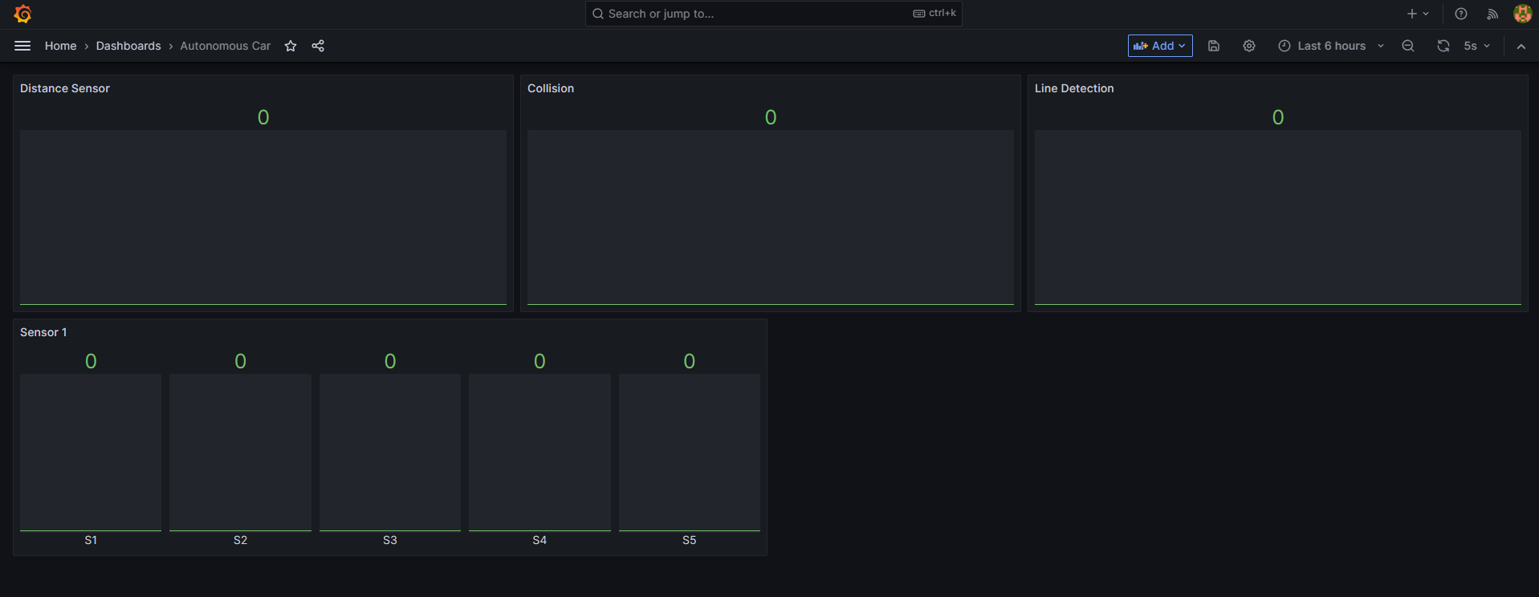
Webinterface

Slide 5
Specs
1 Dual-core ESP-32
1 I/O Expander
1 L293d Quadruple Half-H Driver
2 5V DC-motor
1 5xTCRT5000 IR sensor
1 LM 1117 T5,0 Voltage Regulator

Slide 6
Con
Rommelig prototype
Onafgewerkt

Slide 7
Pro
Het volgt de lijn
Duidelijke Batterij indicatie
Obstacle en Collision detection

Slide 8
Demo Time

